Slide 1
Welcome to Psy 652 Lab! Module 2

Slide 2
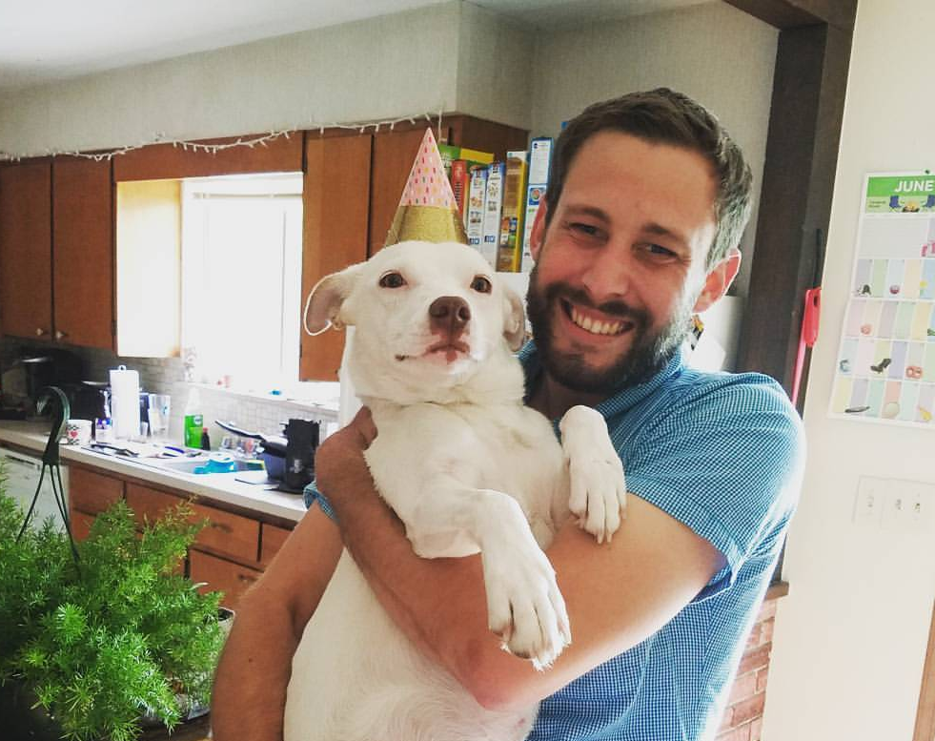
Hello, my name is Neil!
I’m a 4th year Applied Social & Health Psychology Student
I’m a total R nerd
Yes, I use R on my free time
I’m looking forward to teaching you!
Don’t hesitate to ask me questions, friends!
I would love to get to know YOU, too!

Slide 3
To be covered today
Talk about R-Projects, Rstudio, and R-Notebooks!
Hopefully, you can follow along!

